Slide 1
Chatbot Anatomy

Slide 2
Chatbot Definition
Chatbot Process Flow
Coding Exercise

Slide 3
What is a Chatbot?
A chatbot is a software application used to conduct conversations.
It mimics human conversational abilities using Natural Language Processing (NLP).
Modern chatbots leverage LLMs like GPT-4 and frameworks such as LangChain to generate responses.
Our chatbot will integrate with OpenAI's API to generate natural language responses.

Slide 4
Better set up to how to deliver a high quality Q&A for it’s users
What are people looking for
What do they usually receive

Slide 5
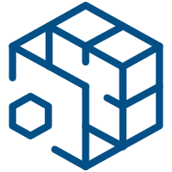



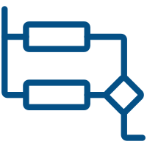


GenAI Solutions follow a similar high-level ‘workflow’
1. Ensure Your Data & Systems are ‘GenAI-Ready’
7. Deliver a High-Quality Response
2. Understand the User’s Request
StrOutputParser
Get answers from OpenAI’s LLM
6. Check for Quality and ‘Toxicity’
High-Level
GenAI
Flow
3. Route the Request(s)
LangChain Expression Language (LCEL)
5. Generate a Targeted Response
4. Aggregate Required Data & Context
Prompt Management

Slide 6
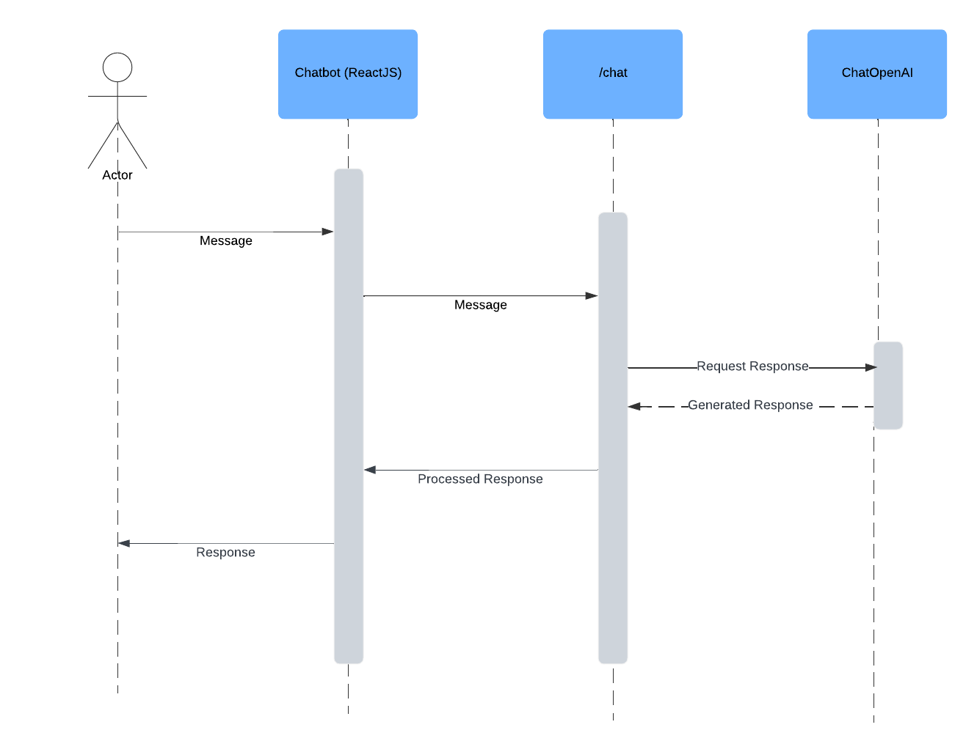
Base Q&A Chatbot Flow
Sequence Diagram

Slide 7
Q&A

Slide 8
Environment Setup
> INSTRUCTIONS - TODO
> <<docker image>>
> cd Enterprise-LLM-RAG/lessons/01-chatbot

Slide 9
Coding Exercise
> <<docker image>>
> cd Enterprise-LLM-RAG/lessons/01-chatbot

